Slide 1






FIGURE YOUR BEST LIFE
COTTAGECORE LIFE SIMULATOR 1

Slide 2
RULES
To play, choose a character and face different life choices you could face living in a cottage on a country side
There are no wrong answers, it is all about you

Slide 3
CHOOSE A PART
CHARACTER CUSTOMIZATION
HOUSE
WELCOME
Other projects by PFK

Slide 4

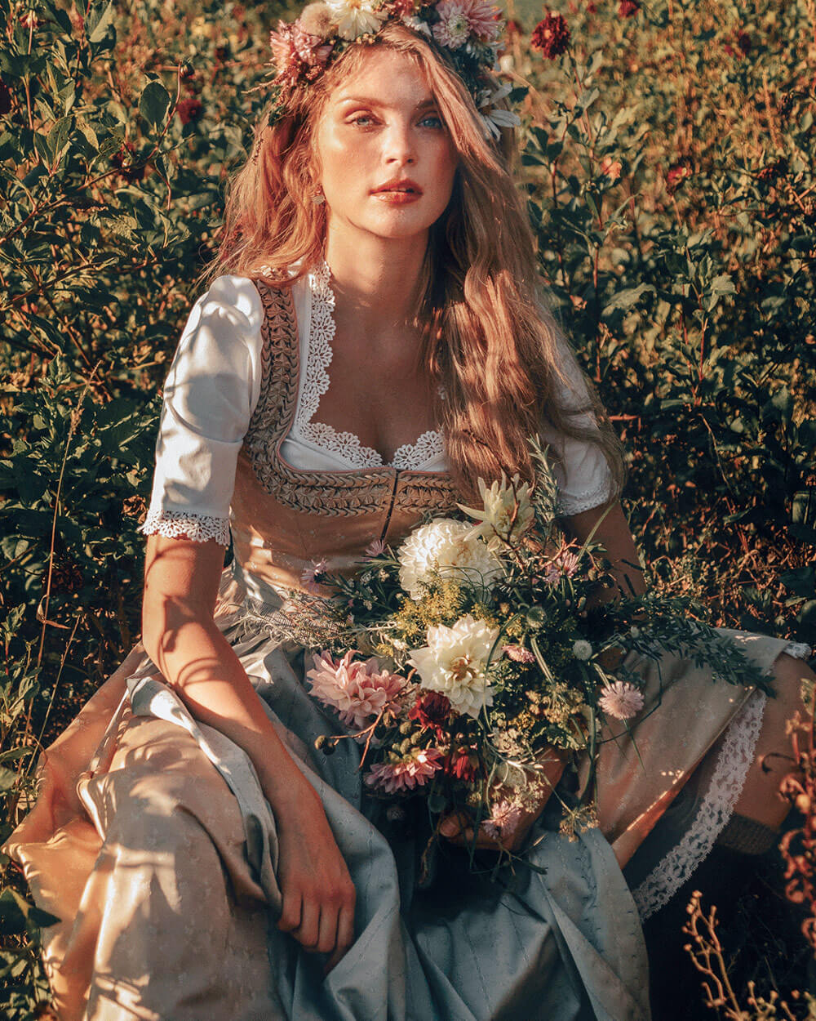

Choose a character

Slide 5
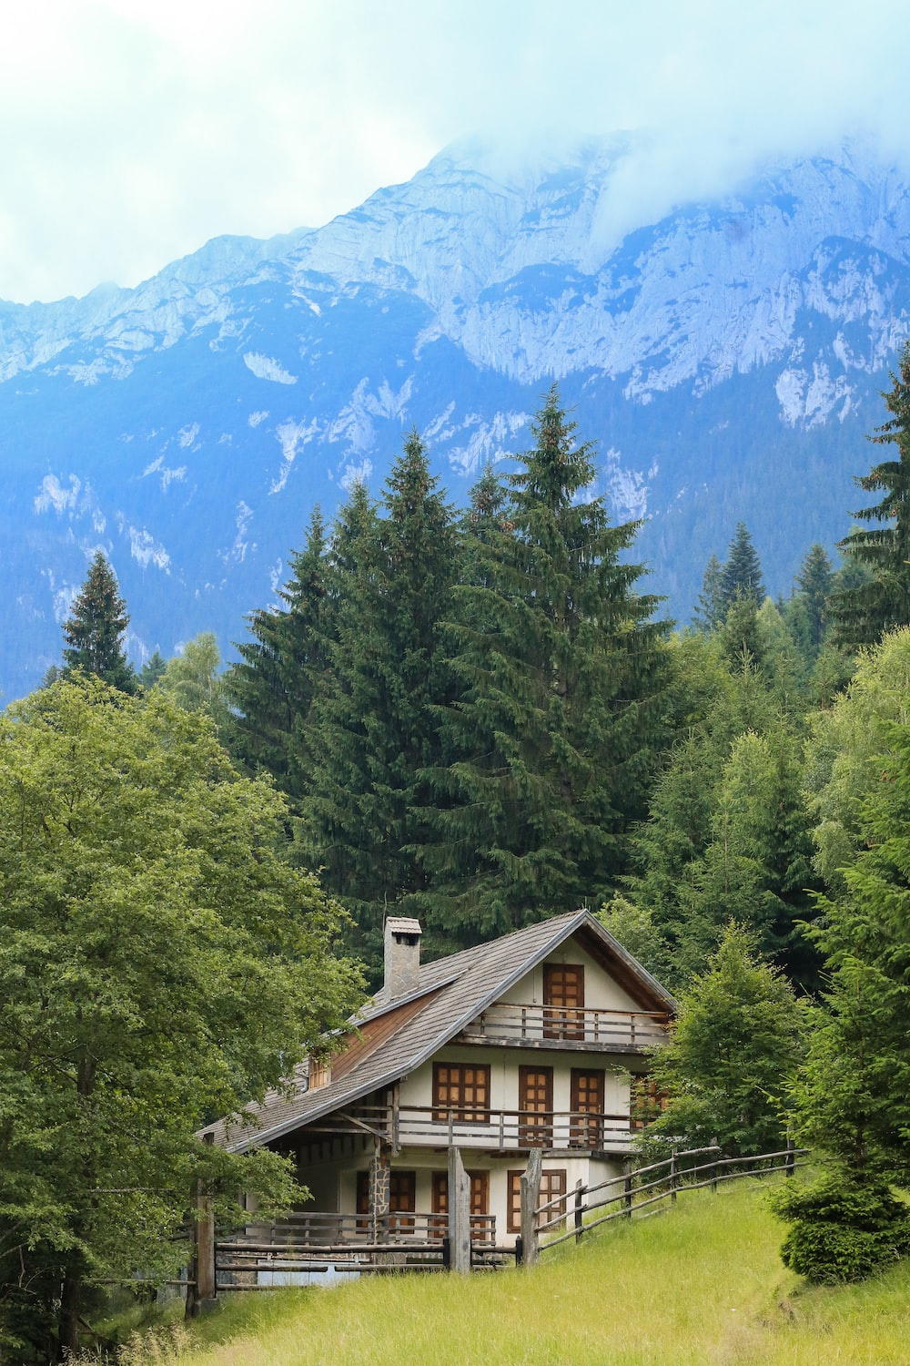
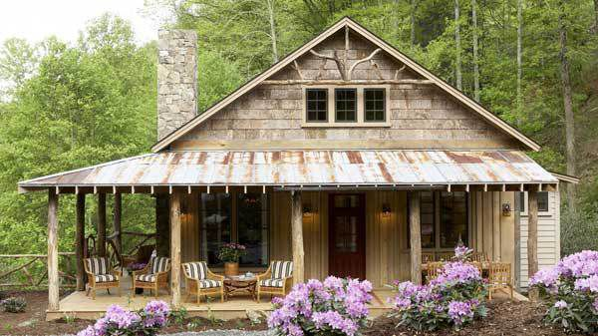
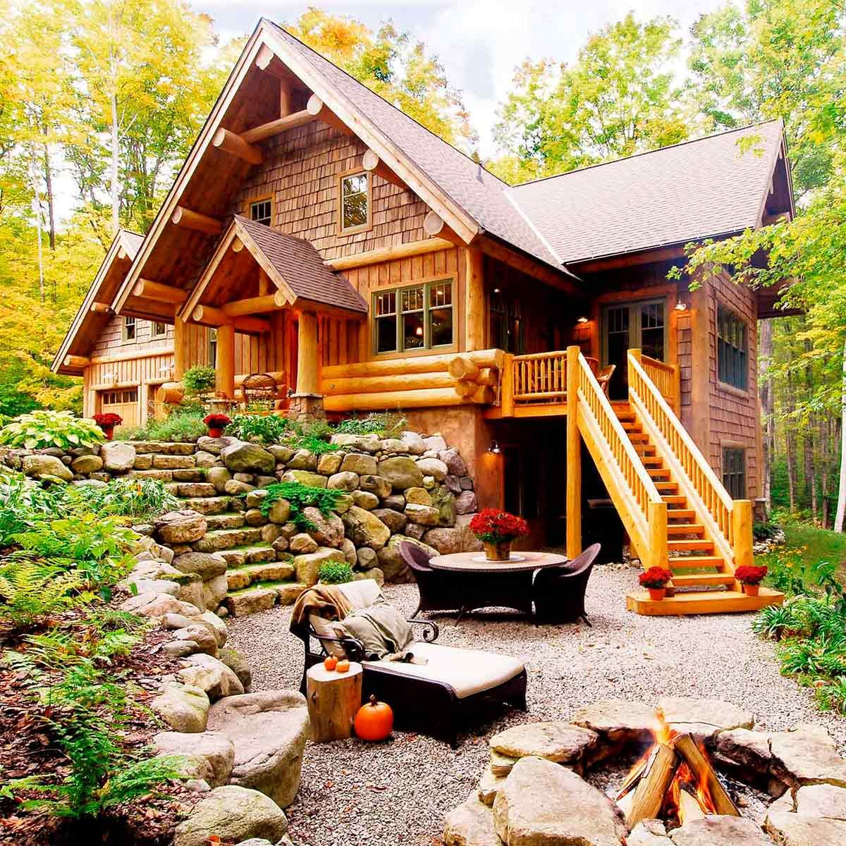
Choose a house

Slide 6
Choose chapter
Chapter 1 – Welcome to your new house
Chapter 2 – Spring begins
Chapter 3 – Bear with me
Chapter 4 – Autunum vibes
Chapter 5 – Snow capped mountains

Slide 7
CHAPTER 1
You will settle in your new home
You will find new frieds
You will experience first night in a forest
If you choose well, you will see a beautifull Aurora

Slide 8
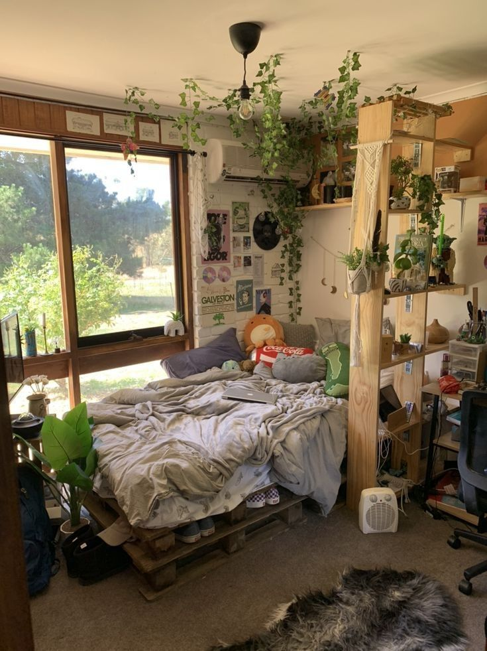


Welcome to your house, choose your new room!
*Choose viseley

Slide 9
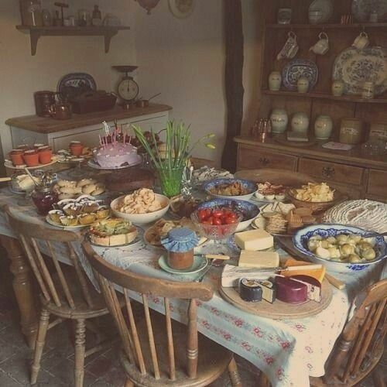
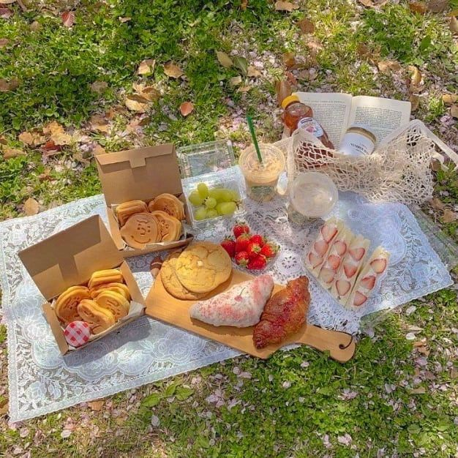
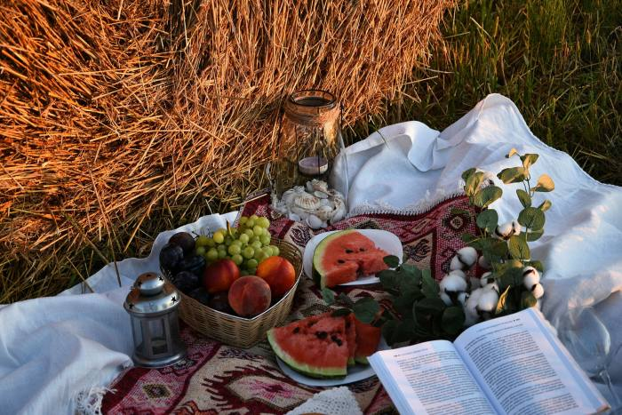
Time for lunch, choose your food!
Choose something that will keep you healthy

Slide 10
Choose
It is still quite cold outside, not really time for your ideal picnic
CHOOSE AGAIN

Slide 11
You had a nice lunch, choose what to do now
READ A BOOK
WATCH A SHOW
GO TAKE A NAP

Slide 12


WHAT TO READ?

Slide 13
You finished your book, choose what to do now
Go for a walk
Go draw
Go on your phone

Slide 14


What to watch?

Slide 15
You finished your show, what now?
Go for a walk
Go draw
Go on your phone

Slide 16
You woke up, what now?
Go for a walk
Go draw
Go on your phone

Slide 17


What to do on it?

Slide 18


Where to go?

Slide 19

Congratulations, you found a flower field!

Slide 20
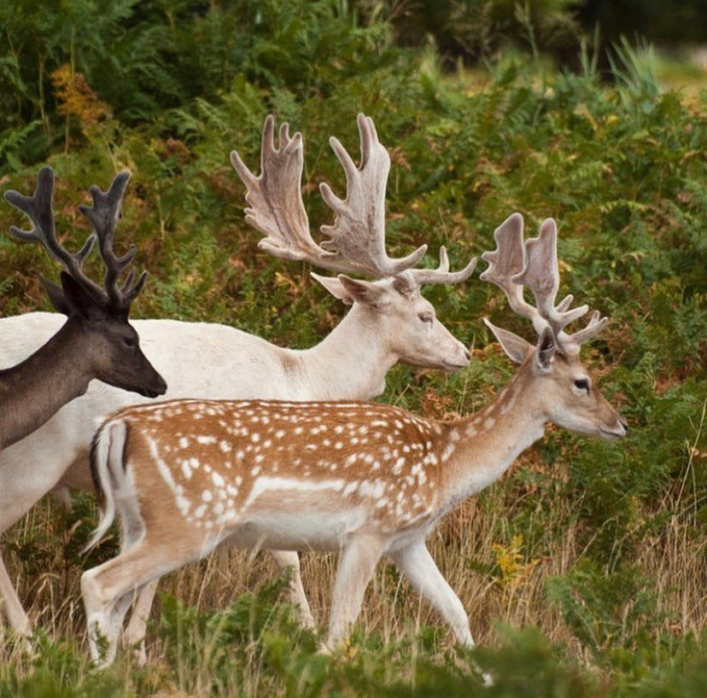
Congratulations, you met wild animals!

Slide 21

Look what you drew!

Slide 22

Congratulations, you finished first chapter!
You choose well and saw aurora.
Chapter 2

